Slide 1
Does Educational Spending Effect SAT Scores?
By John Incantalupo

Slide 2
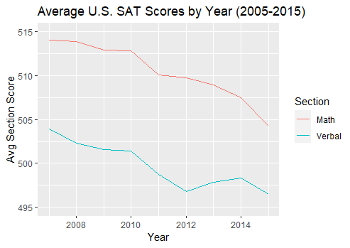
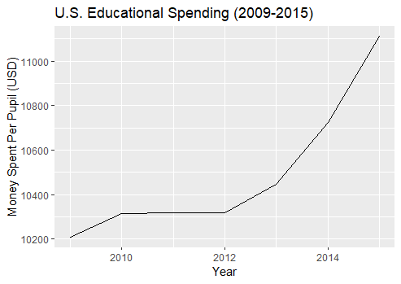
The Problem at Hand

Slide 3

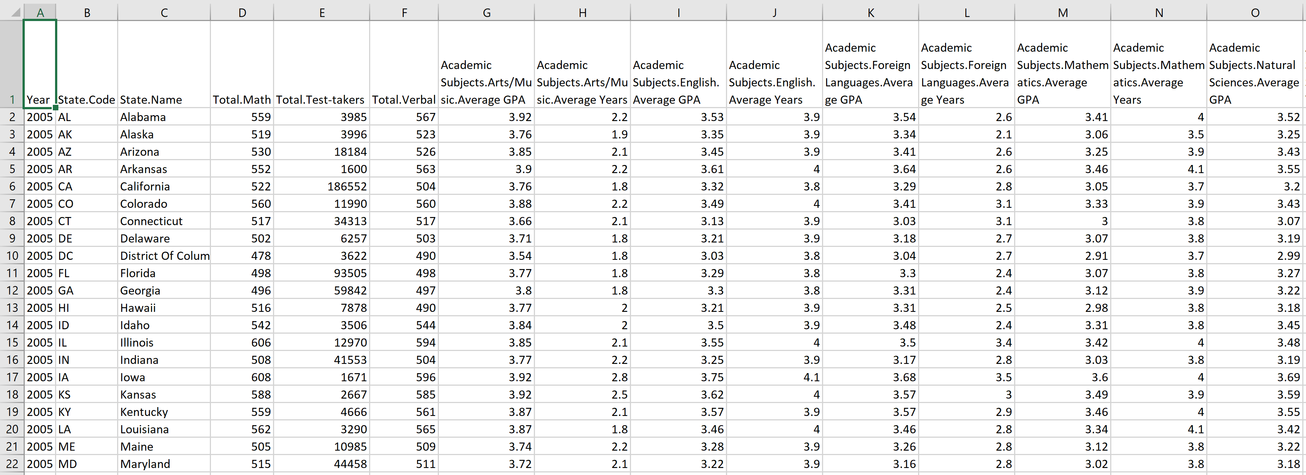
The Data

Slide 4
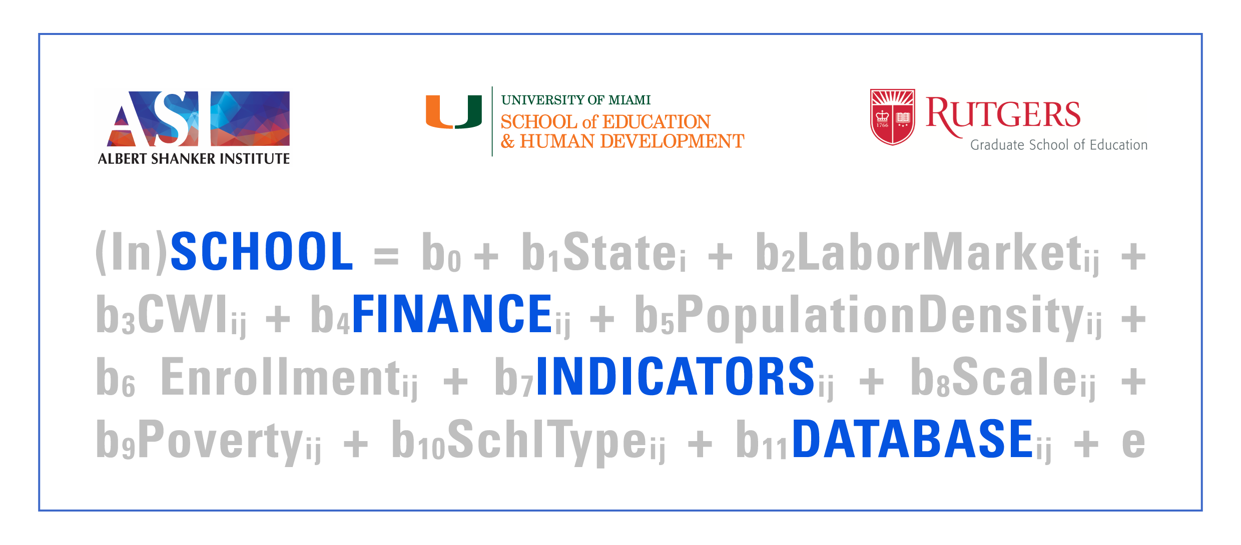
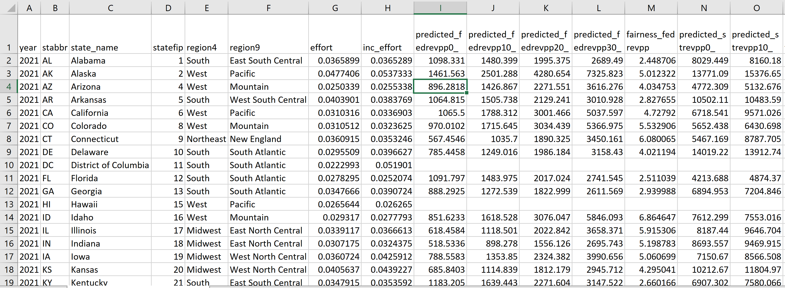
The Data (cont.)

Slide 5
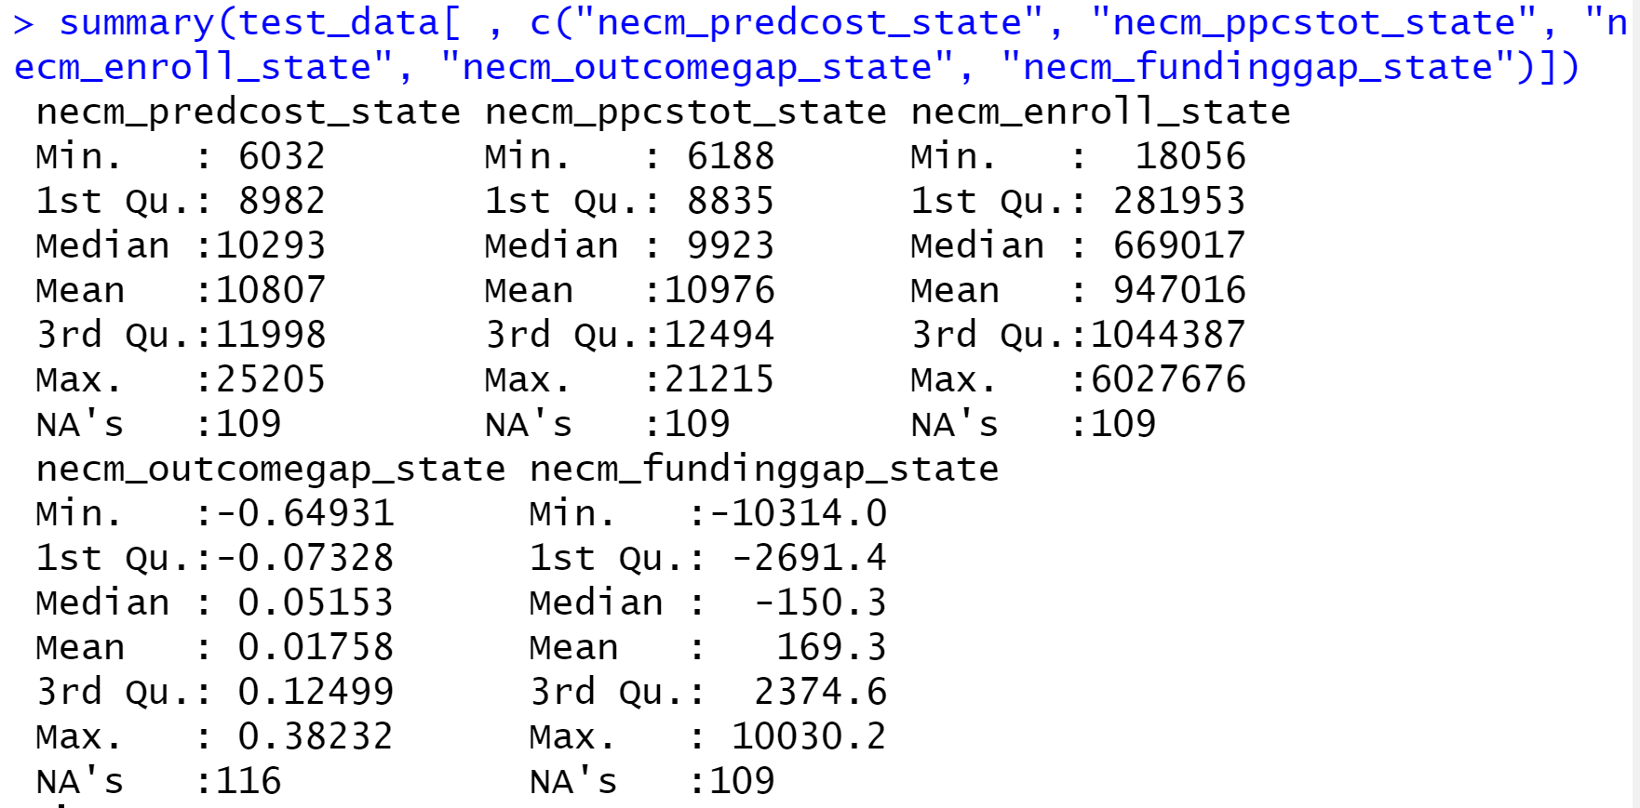
Issues with Merging the Two Datasets
Inconsistent measurement of family income brackets between the two datasets
Funding data is missing before 2009 as well as in Hawaii
NCES Income Groups | SFID Income Groups
Less than $20k/year | Q1: Less than 20th percentile
Between $20k-$40k | Q2: Between 20th and 40th pct
Between $40k-$60k | Q3: Between 40th and 60th pct
Between $60k-$80k | Q4: Between 60th and 80th pct
Between $80k-$100k | Q5: Above 80th pct
More than $100k

Slide 6
Important Variables
NCES Testing Data
Total.Math, Total.Verbal – the average SAT score in a given state in a given year
Total.Test-takers – number of SAT takers in a given state in a given year
Family.Income.Between.xx.yyk.Math/Verbal – average SAT section score for students of families with income between $xx and $yy thousand per year
SFID Spending Data
necm_ppcstot_state/q1 – actual average spending per pupil statewide/lowest (Q1) poverty districts
necm_predcost_state/q1 – average spending per pupil needed in order to achieve the national average in test scores
necm_fundinggap_state/q1 – difference between predicted and actual spending per pupil
necm_enroll_state/q1 – total enrollment statewide/lowest (Q1) poverty districts
sal_parity_25 – ratio between average salaries of teachers and non-teachers ages 25-35

Slide 7
Created Variables
Total.Score – Total.Math + Total.Verbal
Avg.Inc – average income across all families, both public and non-public school
q1_pct - % of enrolled students who come from the highest (Q1) poverty districts
ppcstot_state/q1_inf – actual spending per pupil adjusted for inflation (+1.67% per year between 2009, the first year where funding data is available, and 2015)
predcost_state/q1_inf – predicted spending per pupil adjusted for inflation
fundinggap_state/q1_inf – difference between predicted and actual spending per pupil adjusted for inflation
Total.Score.xx.yyk – average SAT total score for students of families with income between $xx and $yy thousand per year

Slide 8
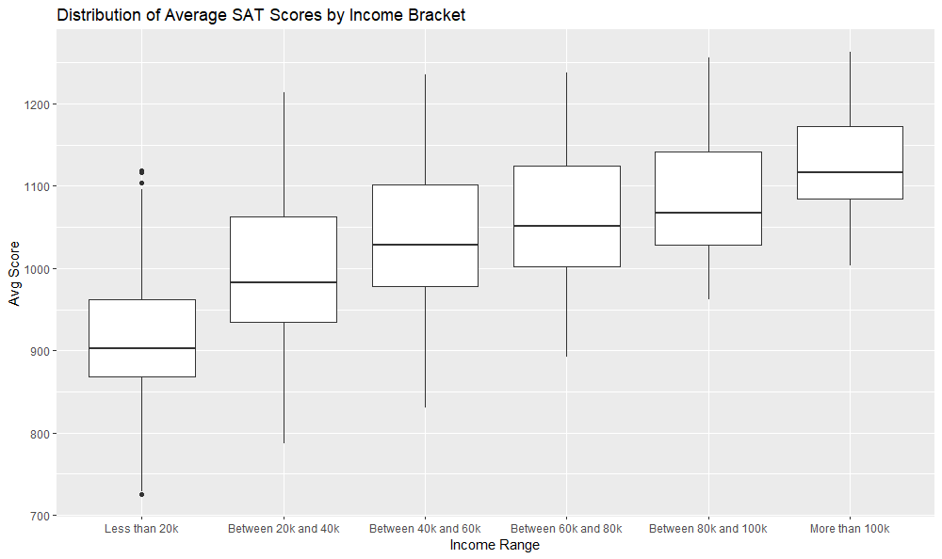
Distribution of Average SAT Scores Grouped by NCES’s Income Brackets

Slide 9
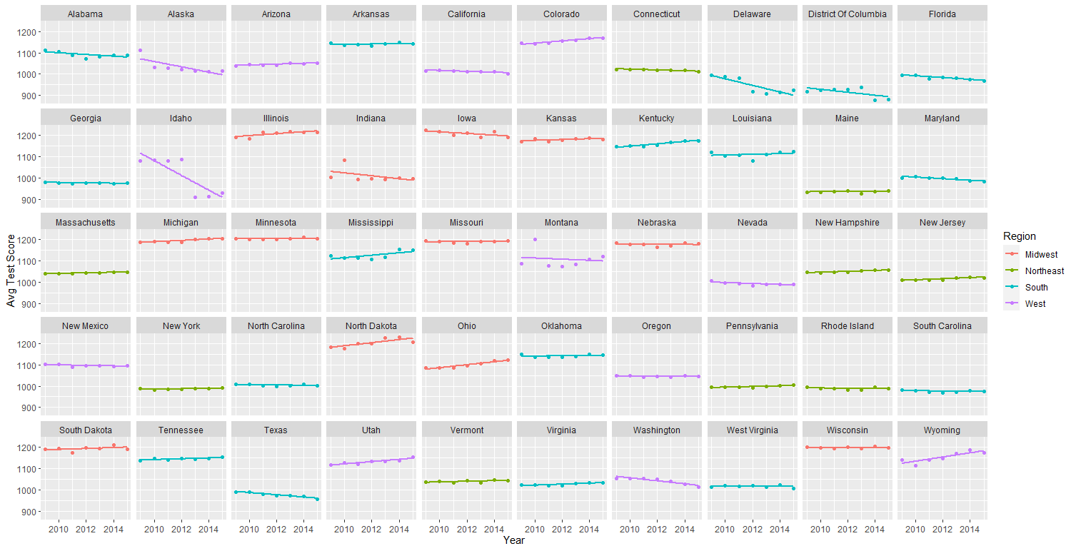
Comparing Each State’s Test Scores by Year (2009-2015)

Slide 10
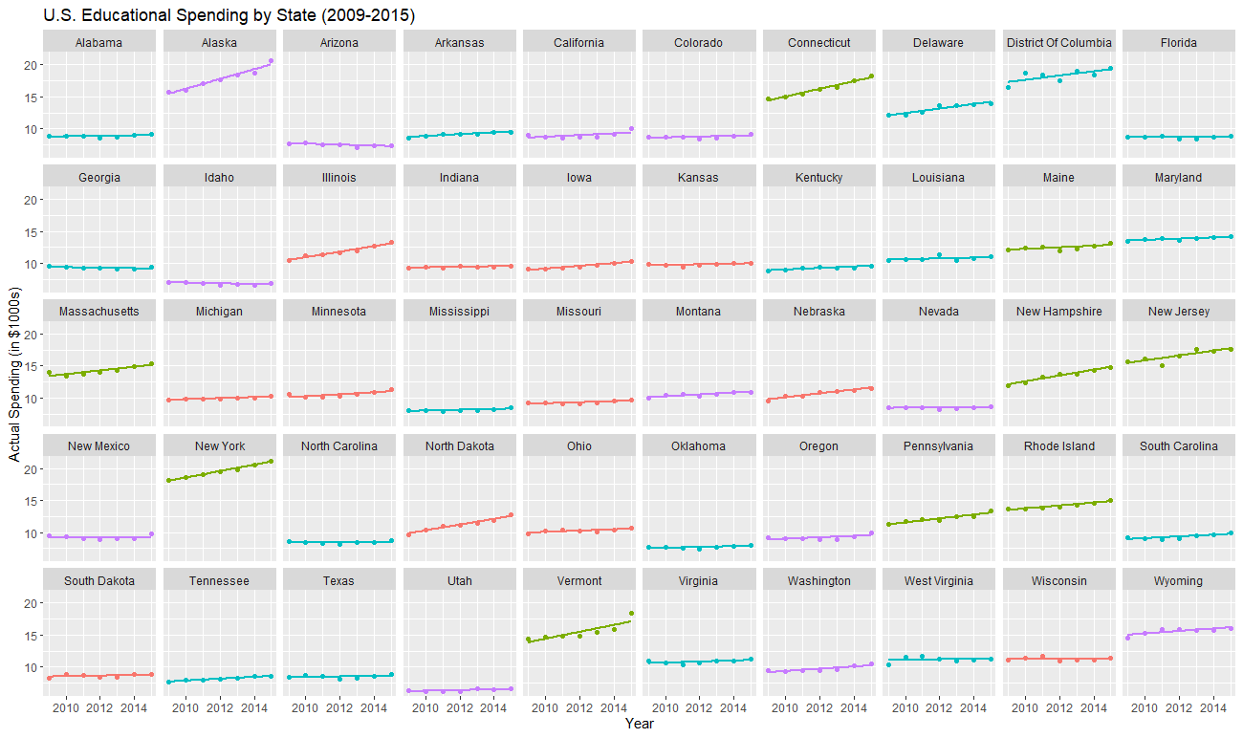
Comparing Each State’s Educational Spending by Year
Only 5 states with a negative slope:
Arizona (-$73.61 per year)
Idaho (-$54.34)
Georgia (-$41.94)
Wisconsin (-$6.05)
Florida (-$2.26)

Slide 11
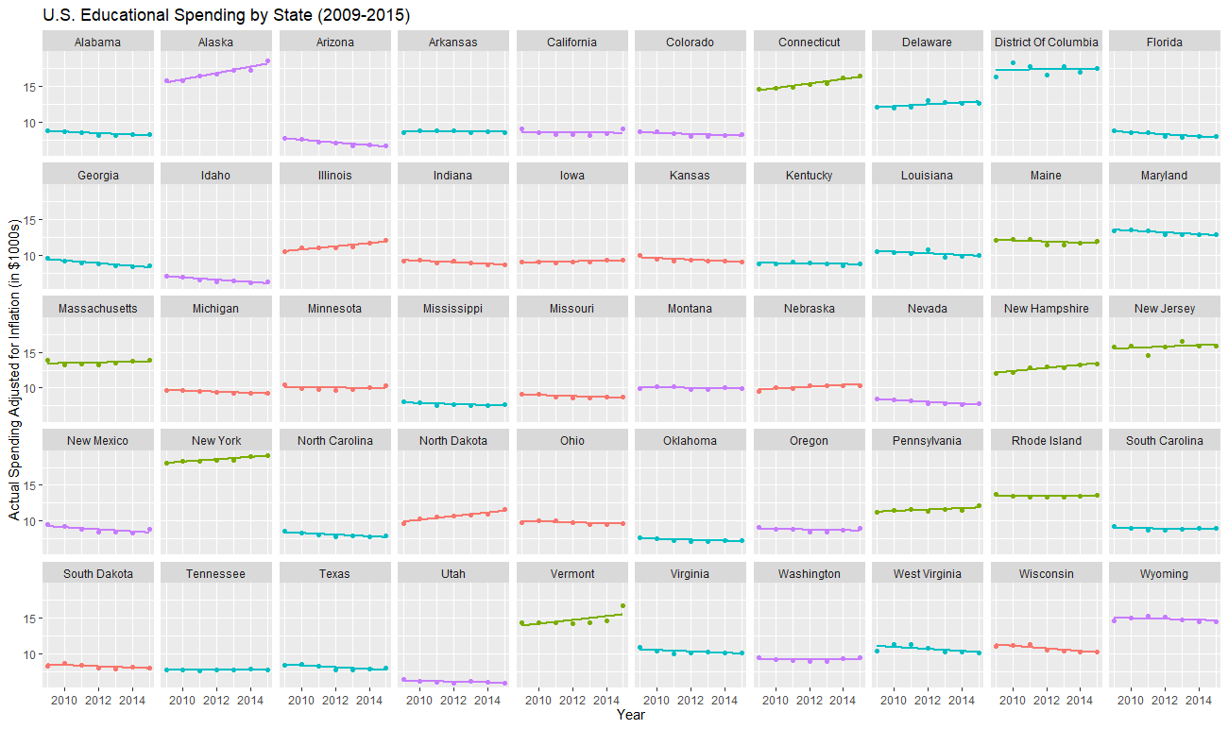
Adjusting the Previous Plot for Inflation
Only 16 states with a positive slope:
Alaska (+$443.85 per year)
Connecticut (+$313.32)
Vermont (+$264.46)
North Dakota (+$251.78)
Illinois (+$223.16)
New Hampshire (+$221.36)
New York (+$166.49)
Delaware (+$134.20)
Nebraska (+$124.21)
New Jersey (+$98.02)
Pennsylvania (+$97.22)
Iowa (+$53.24)
Massachusetts (+$46.19)
DC (+$26.82)
Washington (+$13.68)
Tennessee (+$9.55)

Slide 12
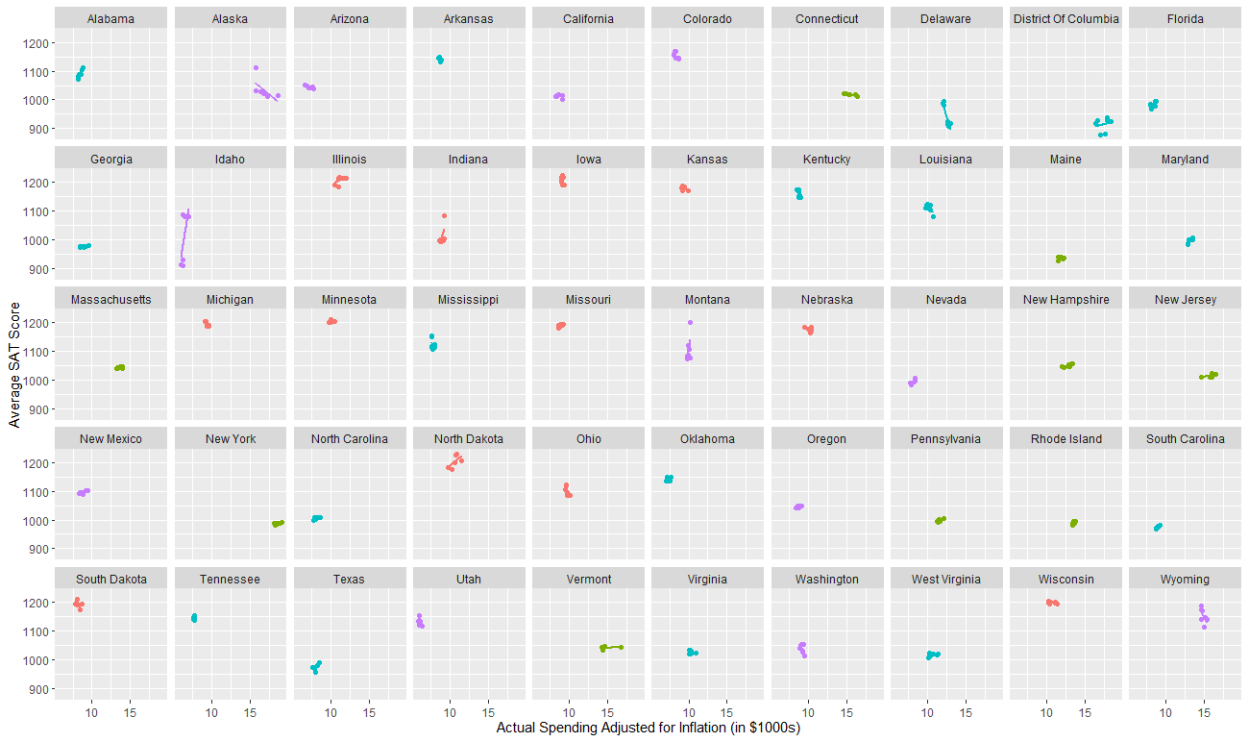
Comparing Actual Spending vs Test Scores

Slide 13
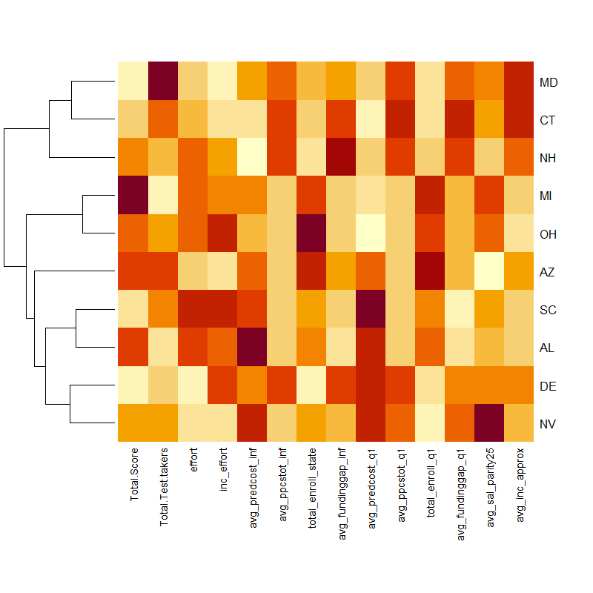
States with Highest Correlation between Spending and Test Scores

Slide 14
Project Takeaways
Income DOES play a role in test scores.
The increase in spending is deceiving. When accounting for inflation, most states are actually decreasing educational spending.
Even when looking at actual spending per pupil, which should remove any biases towards the biggest and smallest states, it seems to be negatively correlated with student enrollment.

